Slide 1
Gift Giving Personal Items
Basic 1 – Unit 3 a

Slide 2

What is this called in English?
It is a box.

Slide 3
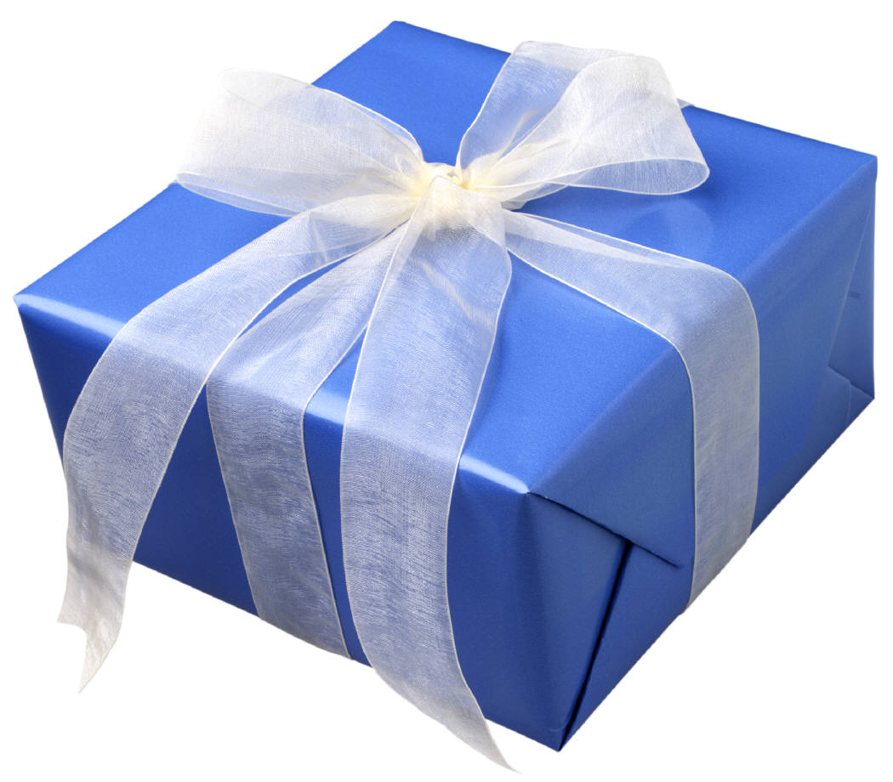
What is this called in English?
It is a gift.

Slide 4
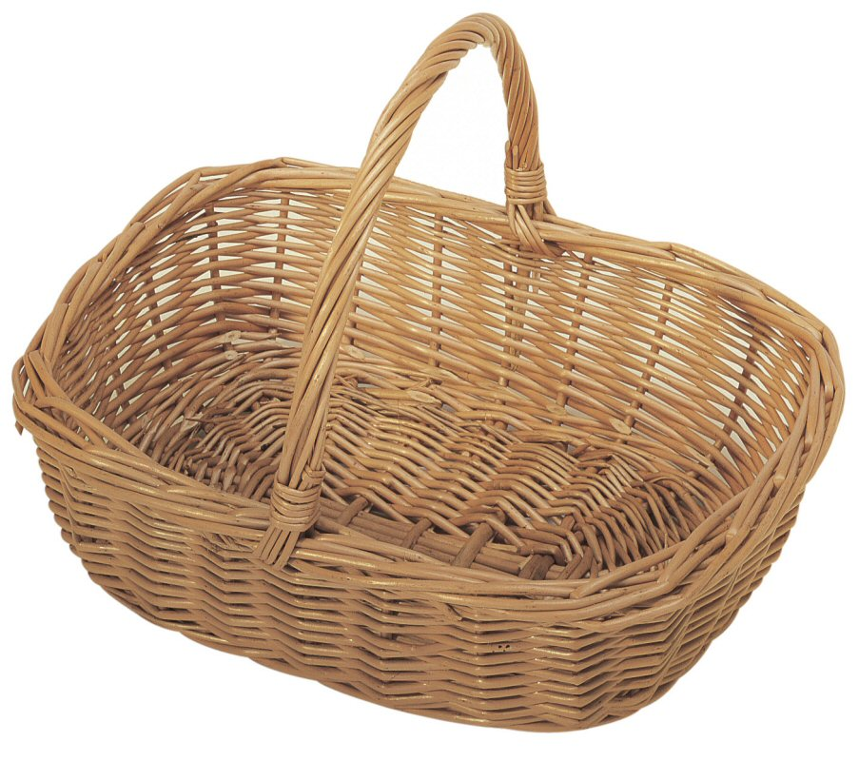
What is this called in English?
It is a basket

Slide 5
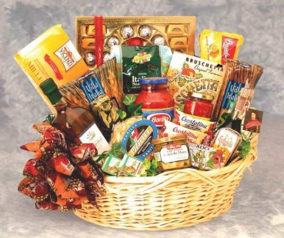
What is this called in English?
It is a gift basket

Slide 6
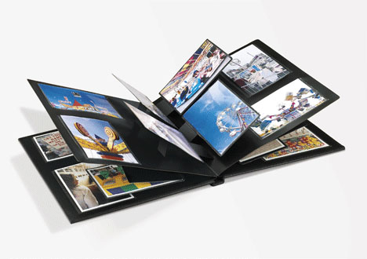
What is this called in English?
It is a photo album.

Slide 7
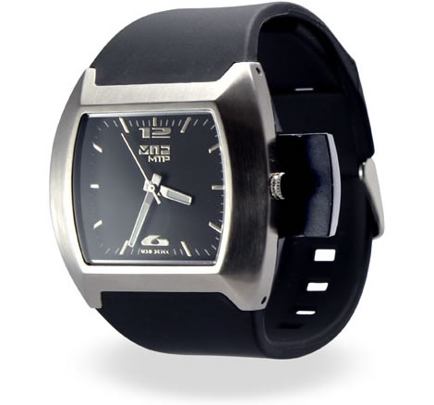
What is this called in English?
It is a watch.

Slide 8
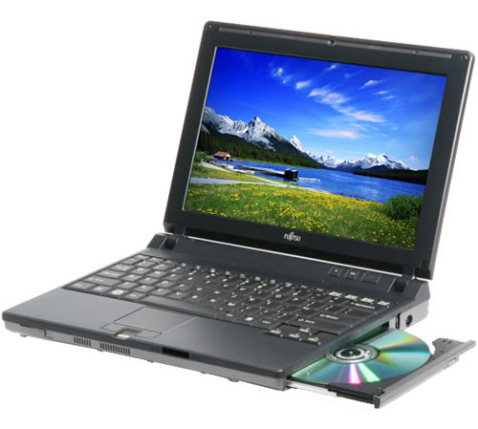
What is this called in English?
It is a laptop.

Slide 9
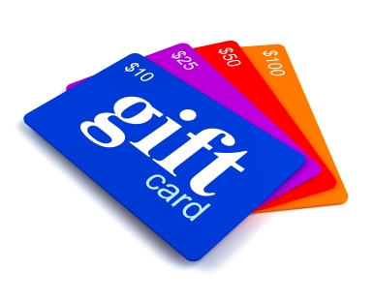
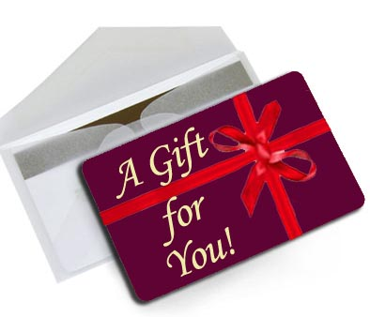
What is this called in English?
It is a gift card.

Slide 10
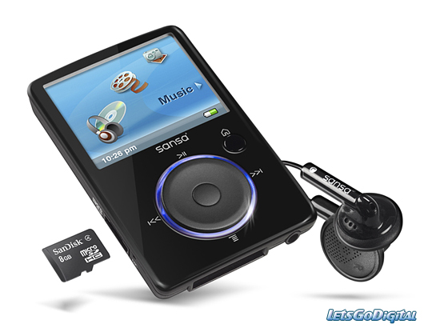
What is this called in English?
It is an MP3 player.

Slide 11
Listening
The perfect gift

Slide 12

